Slide 1

UNICORN COMPANIES ANALYSIS
UNICORN COMPANIES ANALYSIS
Nawaz Ali
LinkedIn: https://www.linkedin.com/in/nawazali-nadaf/
GitHub: https://github.com/nawazali333T
Tableau: https://public.tableau.com/app/profile/nawaz.ali/viz/Test1_17075953972180/Dashboard2?publish=yes
PRESENTED BY:
Nawaz Ali

Slide 2
About the Project
About the Data
Data Cleaning
Data Exploration
Data Visualization
Dashboard Reporting
CONTENTS

Slide 3
ABOUT THE PROJECT
This project provides insights into the characteristics of unicorn companies (companies whose values are over 1 billion dollars). In particular, Majorly it will find the Solution to the following & Some of Other Scenarios:
Which Unicorn Companies had the Biggest Return of Investment (ROI)?
What is Total Valuation, Funding and Correlation Among it?
Exploring the distribution of Unicorn Companies across different Countries and Cities
Which Industries have the Most Unicorns?
Which Countries have the Most Unicorns?
Which have Funded the Most unicorns?

Slide 4
ABOUT THE DATA
The dataset used in this analysis contains records of 1074 unicorn companies obtained Data from 'Tap Invest'.
The sample size might reduces due to the lack of funding and inaccurate information on the year companies are found.
Each record represent a Unique Unicorn Startup, In the dataset, a total of 1,074 companies have recently gained a Billion dollar valuation deeming them to be Unicorns
It includes the following attributes: Company Name, Valuation, Funding, Continent, Country, City, Industry, Investors, Year Founded, etc.
Microsoft Excel is used for the Data Manipulation and Tableau for the Data Visualization, these tools offer a powerful combination for conducting insightful analysis and creating visually appealing visualizations.

Slide 5
DATA CLEANING
In this project, we mainly used Excel, Tableau for both data cleaning and exploration.
Data cleaning steps include:
Check for duplicates, null values, etc
Rename columns where necessary
Standardize date format
Drop rows with errors if required
Reformat currency values (e.g., $2M => 2,000,000)
Generate new columns based on existing column values
Delete unused columns or rows

Slide 6
DATA EXPLORATION
Excel steps involved:
Data Cleansing & Preparation
Descriptive Statistics
Conditional Formatting
Named Ranges & Tables
Logical & Lookup, Vlookup
Aggregate Functions
Data Types Conversion
Pivot tables & charts
Interative Analysis

Slide 7
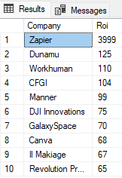
DATA EXPLORATION
1. Which unicorn companies have had the biggest return on investment (ROI)?
This query output shows the top 10 companies with the biggest ROI. Zapier achieved the biggest ROI of 3999 percent. Dunamu comes second with 125 percent ROI, and Workhuman is third with 110 percent ROI.
Zapier’s ROI is significantly high compared to other companies.
ROI = ((Valuation — Funding) / Funding)

Slide 8
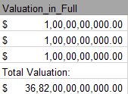
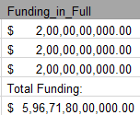
DATA EXPLORATION
2. What is Total Valuation, Funding and Correlation Among it?
The total valuation of all unicorn companies in the dataset amounts to $3682 Billion.
This figure represents the combined market value of these companies as of the given date.
The total funding raised by all unicorn companies in the dataset sums up to $596 Billion.
This amount represents the cumulative investment received by these companies from various investors and funding rounds..

Slide 9
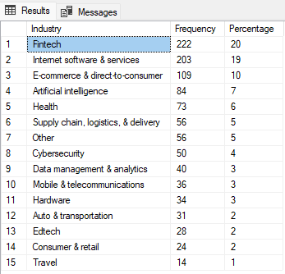
DATA EXPLORATION
3. Which industries have the most unicorns?
Fintech and Internet Software & Services have about 40 percent of total unicorns.
The e-commerce industry also has a
significant share of unicorns of 10 percent.
These figures show the potential of Fintech, Internet software & services, and E-commerce industries.

Slide 10
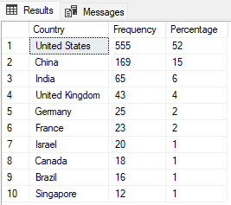
DATA EXPLORATION
4. Which countries have the most unicorns?
It is interesting (but not surprising) that the United States has the largest share of unicorns.
China and India, the countries with the largest share of the world population, have percent share of unicorns, respectively.

Slide 11
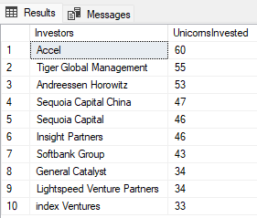
DATA EXPLORATION
5. Which investors have funded the most
unicorns?
This query output shows Accel is the top investor who invests in 60 unicorns.
Based on this project’s scope, Sequoia Capital and Sequoia Capital China are treated as different investors since we will not dive deep into further details.

Slide 12
DATA VISUALIZATION (TABLEAU)
Techniques that I utilized in this project are:
Parameters
Top N filters
Reference lines
Calculated fields
Map Visualization
Bar Charts, Scatter Plot, Graphs ,etc
Dashboard Reporting

Slide 13
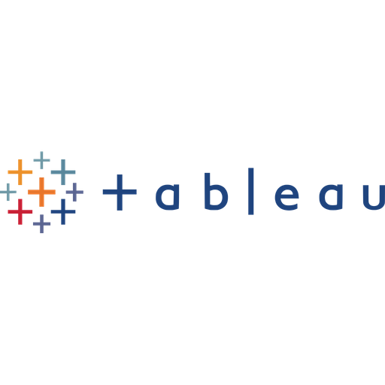
DASHBOARD REPORTING

Slide 14
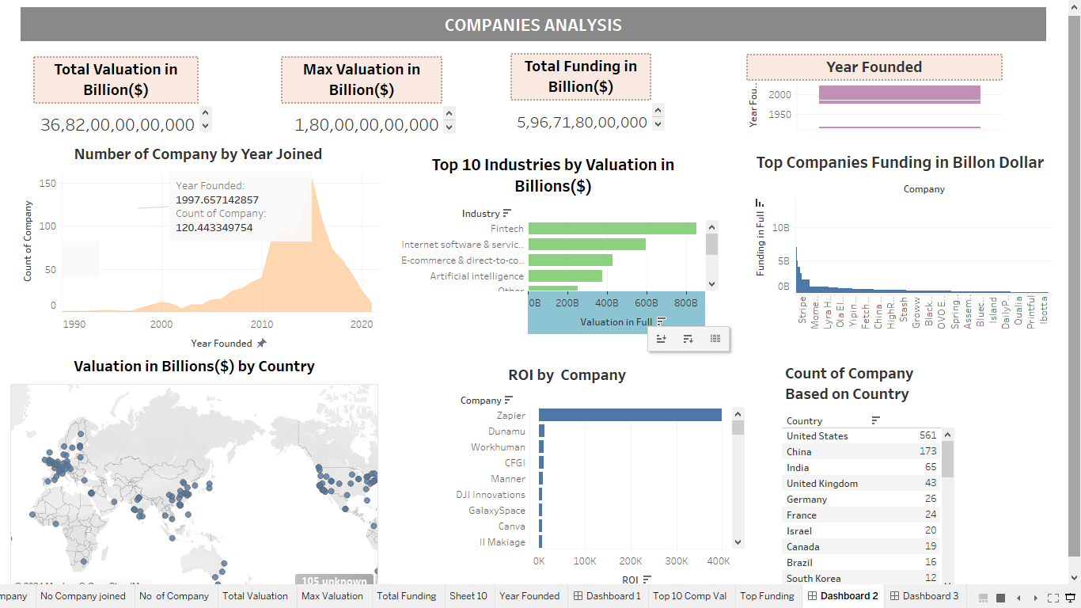
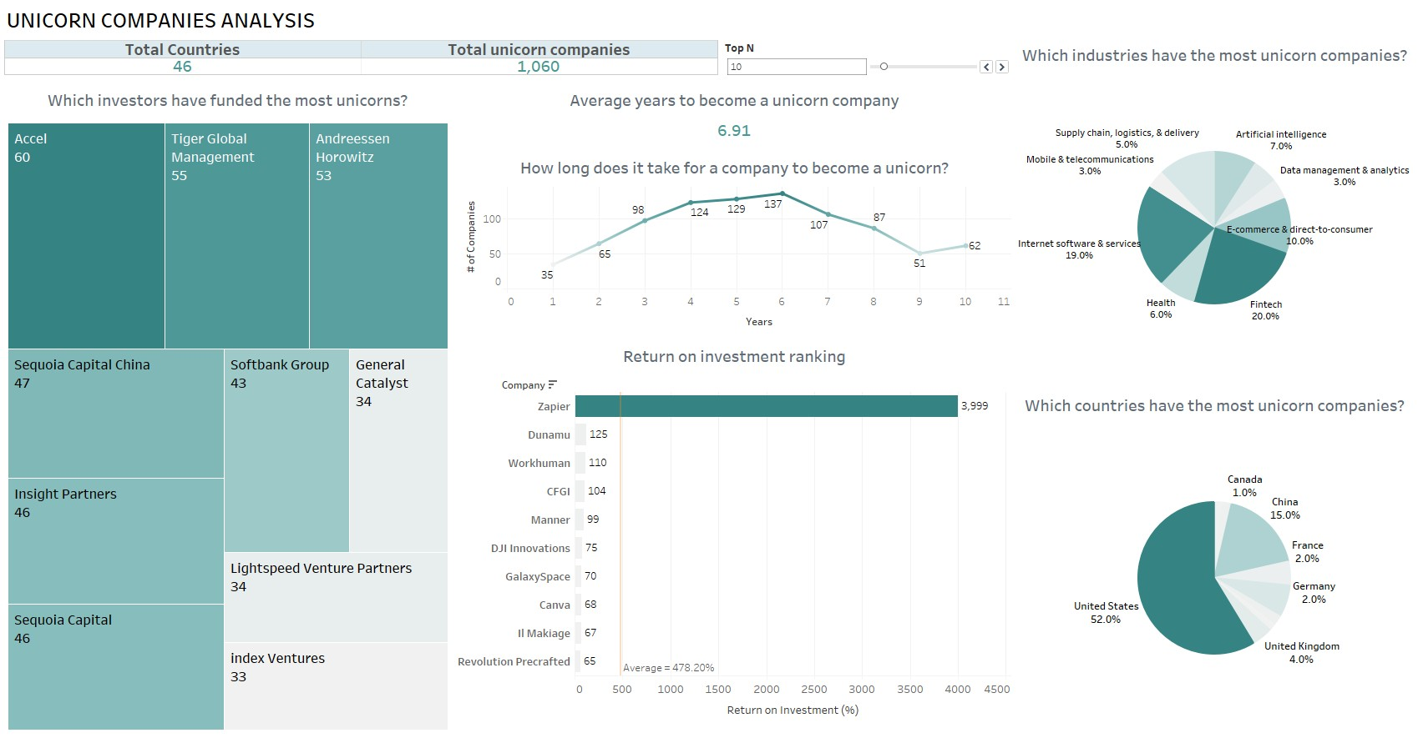
Link: Unicorn Companies Analysis | Tableau Public

Slide 15
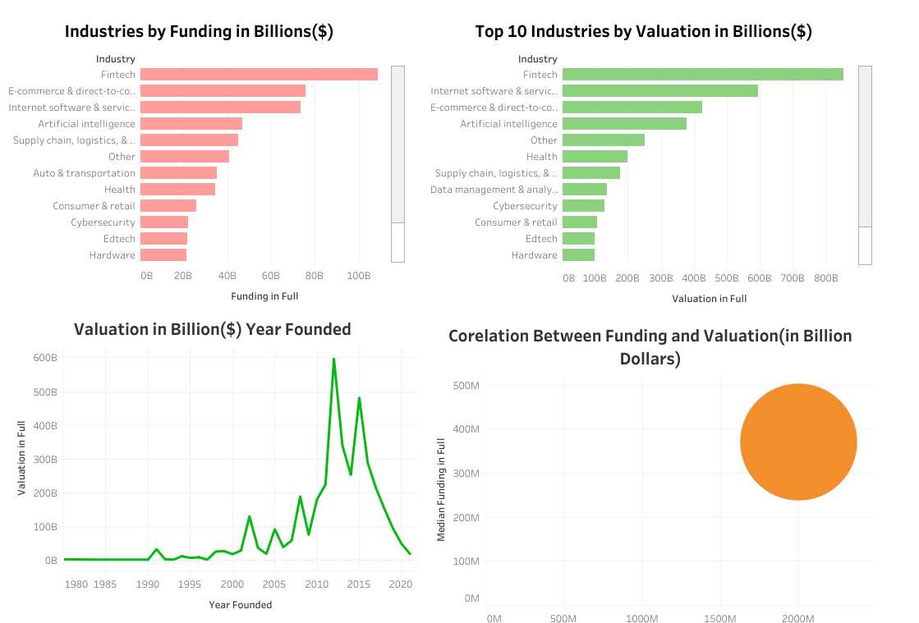

Slide 16



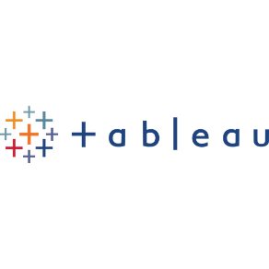
CELL PHONE
+ 916363315219
THANK YOU
ADDRESS
BANGALORE, KARNATAKA
EMAIL
Nawazali.nadaf@outlook.com
https://www.linkedin.com/in/nawazali-nadaf/
https://github.com/nawazali333
https://public.tableau.com/app/profile/nawaz.ali

